Slide 1
Blind estimation of acoustic transfer functions (ATFs) and dereverberation based on convolutive transfer functions (CTFs) Date：2022. 09. 06
Telecom Electroacoustics Audio(TEA) Lab
Presenter:
Anchi Yuan
Notes:
Hello everyone
I’m today’s presenter siang. I’m going to share some of my present work in source separation problem. My topic is comparative studies of source separation using semi-blind and blind source separation approaches.

Slide 2
Outline
Simulation setting
Simulation result

Slide 3
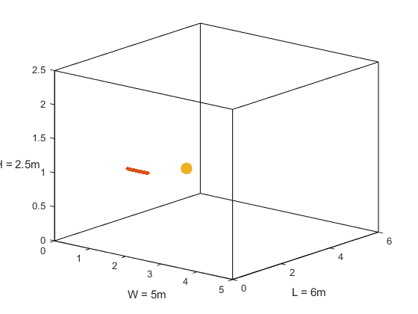
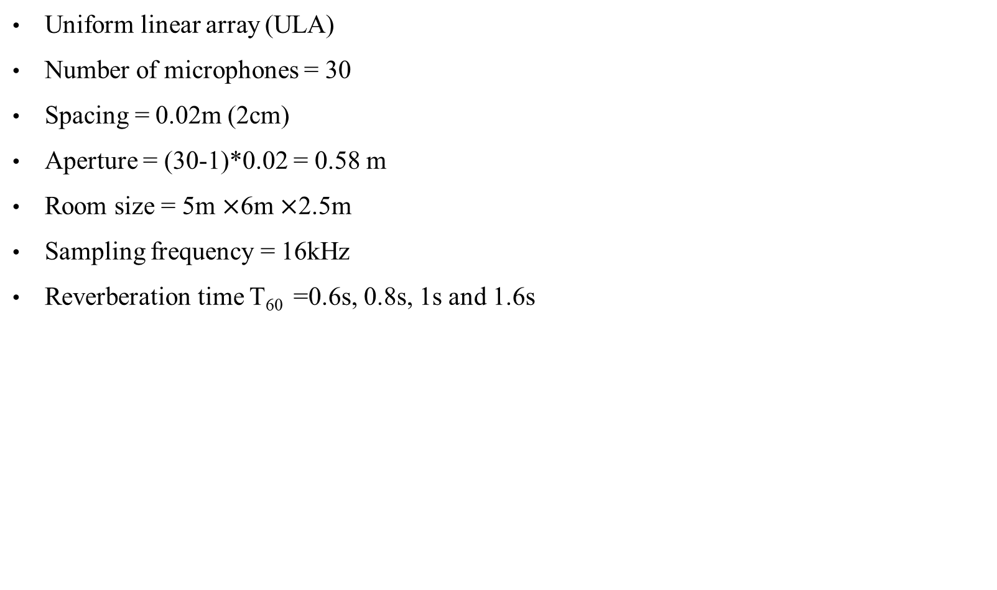
Simulation setting
Uniform linear array (ULA)
Number of microphones = 30
Spacing = 0.02m (2cm)
Aperture = (30-1)*0.02 = 0.58 m
Room size = 5m $×$6m $×$2.5m
Sampling frequency = 16kHz
Reverberation time T₆₀ =0.6s, 0.8s, 1s and 1.6s
First mic (1, 1.5, 1)
Source (2, 2.6, 1)
mic spacing = 0.02m
z
y
x

Slide 4
Simulation result (1)
Ground-truth RIR
estimated RIR
T₆₀ = 0.8s
T₆₀ = 1s
T₆₀ = 1.6s

Slide 5
Simulation result (2)
10
-10
-30
-50
-70
Magnitude (dB)
0 1000 2000 3000 4000 5000 6000 7000 8000
x10⁴
2
-2
-5
-10
-12
T₆₀ = 0.6s
phase (deg)
------ ground-truth ATF
------ estimated ATF
0 1000 2000 3000 4000 5000 6000 7000 8000
frequency (Hz)

Slide 6

Simulation result (3)
 | Ground-truth source | Microphone received | MINT | WPE
T₆₀ = 0.8s
T₆₀ = 1s
T₆₀ = 1.6s

Slide 7
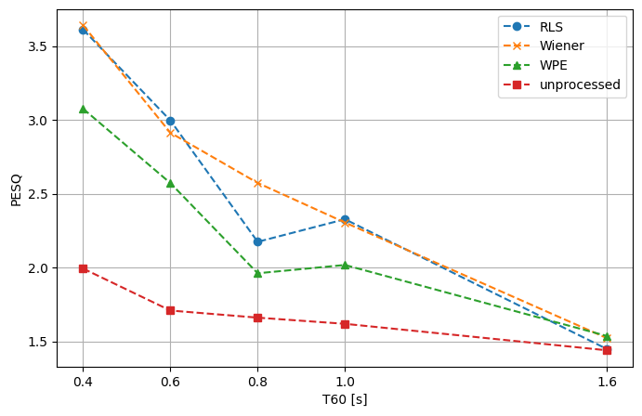
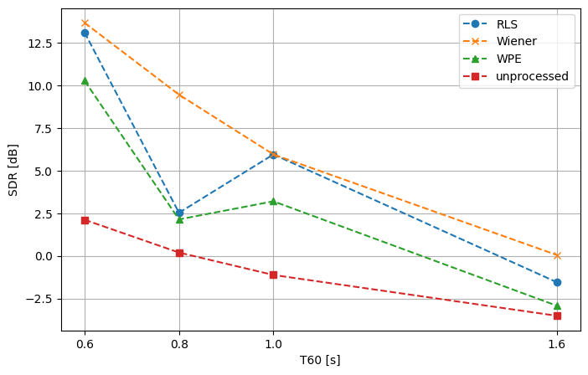
Simulation result (4)
PESQ v.s. T₆₀
SDR v.s. T₆₀

Slide 8


